Slide 1

MINI PROJECT 1-A
(Topic selection)
A.Y-2024-2025
Sakshi Salve
Dhruvraj Wankhade
Mohit Kadam
Agrima Gupte
Computer Science and Engineering
( Data Science )
Notes:
1
1

Slide 2

TOPIC 1 : Quiz Game with Dynamic Leaderboard
Is a quiz game where players can compete in real-time or asynchronously. The SQL database will track users’ scores and dynamically update a leaderboard that reflects the top players globally or within specific categories.

Slide 3
OBJECTIVES
Track and store user performance*: Implement a system that records user scores and ranks the top 10 players globally.
Provide structured quiz data*: Design a database to manage quiz questions and user responses efficiently.

Slide 4
FEATURES
1.Categories & Questions: Players choose from different quiz categories with varied question types.
2.Scoring System: Points based on correctness and speed, with scores updated instantly.
3.Dynamic Leaderboard: Global and category-specific leaderboards, updated in real-time.
4.Backend & Database: Uses SQL for user, score, and game session tracking; WebSockets for real-time interactions.

Slide 5
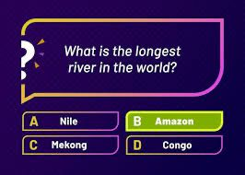
REQUIREMENTS
Visual Studio Code: To Write and Compile the code.
Java: jdk 17
MySql: To store the Data.

Slide 6
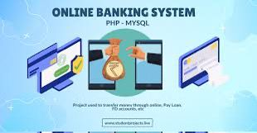
TOPIC 2: Online Banking Portal
This Project aims to transform banking by offering a secure, user-friendly platform for managing accounts, making transactions, and accessing financial tools, all while ensuring a reliable and efficient banking experience.

Slide 7
OBJECTIVE
1. User Authentication*: Ensure secure login and validation of user credentials.
2. Account Management*: Allow users to manage accounts, view transaction history, and check balances.

Slide 8
FEATURES
1. Account Management*: View balances and transaction history.
2. Security*: Multi-factor authentication and encryption.
Personalized Insights*: Budget tracking and spending analysis.

Slide 9

REQUIREMENTS
Programming Language : Java JDK 17
Required Tools: MySQL

Slide 10
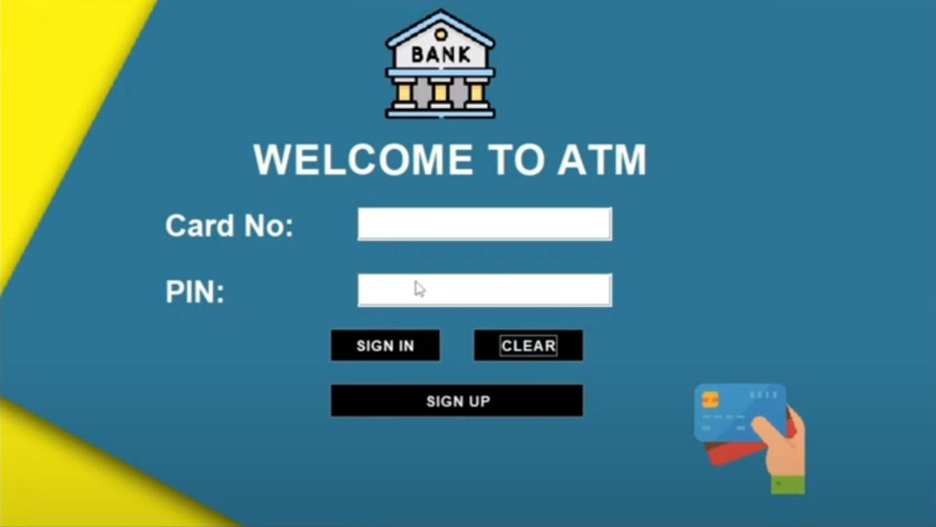
TOPIC 3: ATM MACHINE
The Online ATM Machine replicates real-world ATM operations offering a practical platform for secure login, account management, and financial transactions.
It serves as a valuable tool for banks, developers, and educators to understand and implement banking software solutions.

Slide 11
OBJECTIVES
1. Data Security*: Implement encryption and data storage mechanisms for sensitive information like account details.
2. Fund Transfers*: Enable secure and real-time fund transfers between accounts (internal and external).

Slide 12
FEATURES
Secure Login/Signin Page: Provides a safe and intuitive way to access the ATM Machine.
Account Registration: Allows new users to create an account directly through the Machine.
ATM Machine Interface: Mimics real ATM operations for balance checks, withdrawals, and deposits.
Transaction History: Enables users to view their recent transactions and account activities.

Slide 13
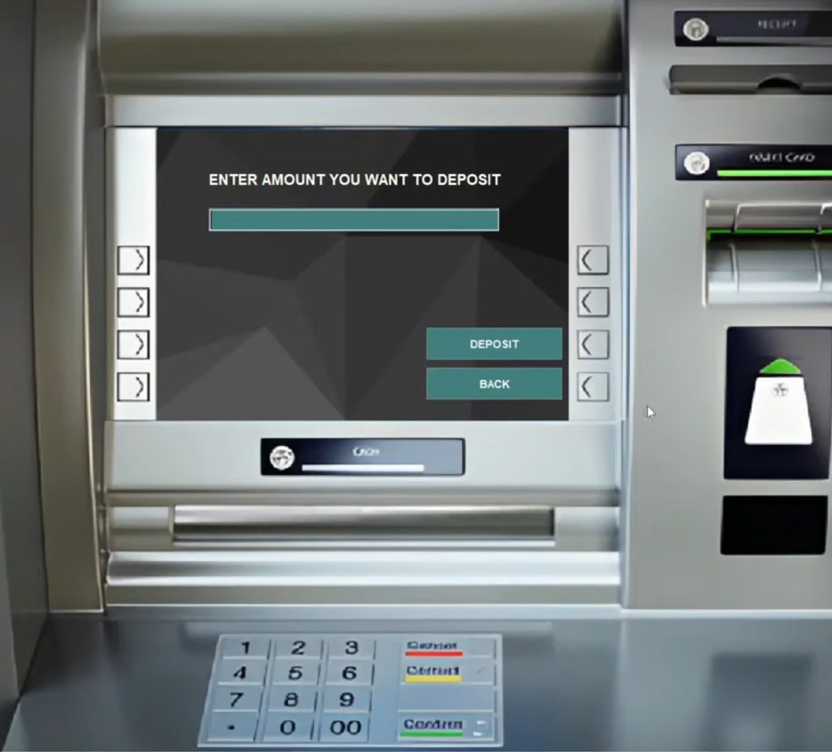
REQUIREMENTS
Visual Studio Code: To Write and Compile the code.
Java: jdk 17
MySql: To store the Data.

Slide 14
Thank You

